Slide 1

DriverPass System Analysis
Clayton Merritt
Notes:
[No speaker notes required for this slide.]

Slide 2

System Requirements
Functional Requirements
The system needs to facilitate the registration of new users, associating information provided by the new user with their account they are trying to create and then store their account in a database to be used later.
The system needs to facilitate the coordination and scheduling of driving appointments based on their availability.
Notes:
[In your speaker notes, include an explanation of the different requirements you determined for DriverPass’s system. What are the functional requirements you selected to describe? What are the nonfunctional requirements you selected to describe? Be sure to explain how these requirements meet DriverPass’s needs.]
The DriverPass program requires three main things to function.
The first of those things: Users needing to be able to register for DriverPass. Without the ability to sign up for the service DriverPass offers, users won’t be able to use it. The system also needs to be able to assign the information that’s given to an account, whether that’s personal information like users username, password, actual name and address, pickup location, or a payment method. Their role, whether a student, administrator, scheduler or driver should also be assigned here. If users are a student, then what package they purchased should be reflected in their account as well as what they have access to also. The rest of this function includes taking the information gathered during registration and then storing it somewhere in the cloud, so when the user logs back in to the DriverPass System, their information will be there and access to requested or required tools will be there for them.
The second of those functions: DriverPass needs to be able to facilitate the coordination and scheduling of driving appointments between students and drivers. Without this function, students wouldn’t get the help they need from the services DriverPass aims to provide. DriverPass should be able take availability provided by both its drivers and students, storing it somewhere in the cloud, and then displaying it in a way that assists the scheduler in coordinating an appointment between both drivers and students. Equally as important to scheduling is the ability to cancel the appointment that was made. Life happens, and this system should accommodate for that.

Slide 3
System Requirements
Non-Functional Requirements
The system needs to tell its users apart, so they have access to tools they need and to provide the services that were paid for.
The system needs to be able to function on commonly used web browsers now, saving the not-so-common browsers for later.
Notes:
[In your speaker notes, include an explanation of the different requirements you determined for DriverPass’s system. What are the functional requirements you selected to describe? What are the nonfunctional requirements you selected to describe? Be sure to explain how these requirements meet DriverPass’s needs.]
Here are some other requirements that we determined will help DriverPass’s overall user experience
DriverPass needs to be able to tell its users apart based on the information that was provided during registration. Keeping users in their lane will make sure that the right people have the right tools at their disposal for what they’re using DriverPass for: Its not just students that will be using the system. Everyone that has any part in the company will be using it too.
DriverPass should be developed for standard desktop and mobile web browsers. We should be thinking about who exactly will be using this application: the standard person on either an average desktop or cell phone. It makes sense to develop DriverPass for what the standard person is using. That means developing DriverPass for Google Chrome, Safari, and Edge browsers. This will make sure DriverPass will be reaching most of your clientele now, while saving clientele who do not use the most common browsers for later.

Slide 4
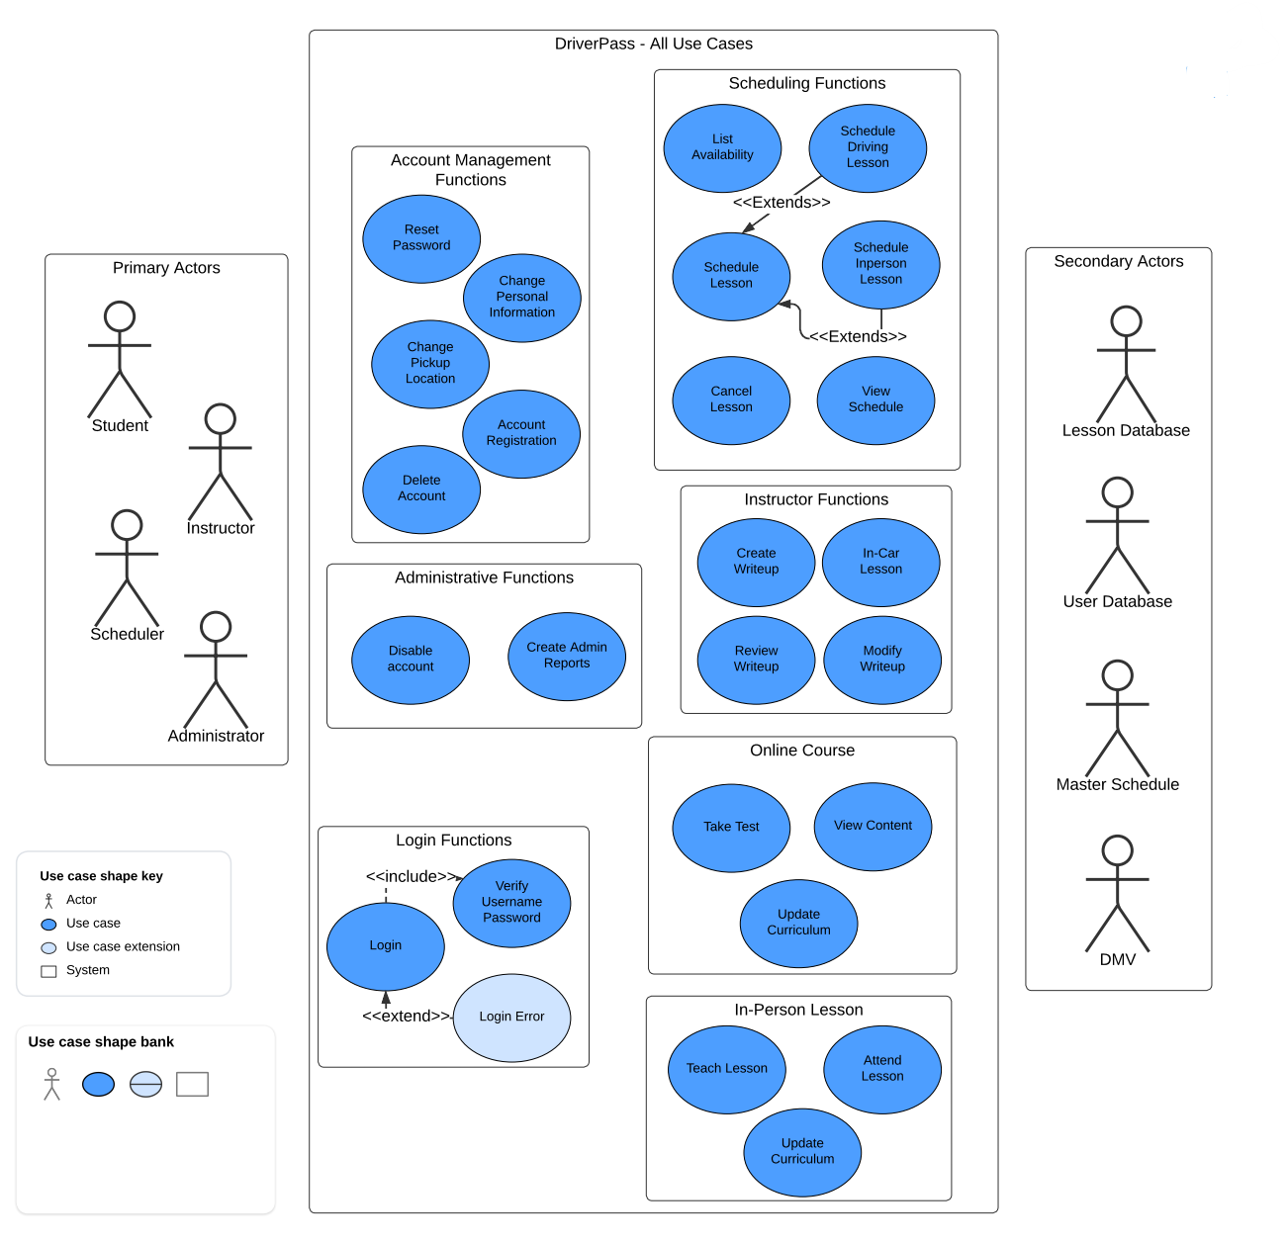
Use Case Diagram
[Insert your use case diagram here.]
Notes:
[Explain your diagram. Who are the different actors in the system? What are the different use cases? How did you account for DriverPass’s needs in your design? In your explanation, keep your audience in mind. Avoid the use of terms like “actors” and “use cases” in your explanation.]
Here is a diagram that shows most of the use cases that will occur within DriverPass.
This slide may seem a a little bit daunting, but take a little time to glance at what is actually there:
The different people that will be using DriverPass on the left: Students, Instructors, Schedulers and Administrators, the actual DriverPass program in the middle with the different tools and functions that those people will be doing with it, and then the different things that the DriverPass program will be interacting with when those tools are used are shown on the right.
Taking a look at the tools and functions that those people will be using, they are grouped together by subject. As an example: different things that can be done that pertain to scheduling can be found within the scheduling functions group. Anything that you would expect the instructor to be able to do, you can find within the instructor functions group, and so fourth. Lets take a closer look at how DriverPass would function as a student.

Slide 5
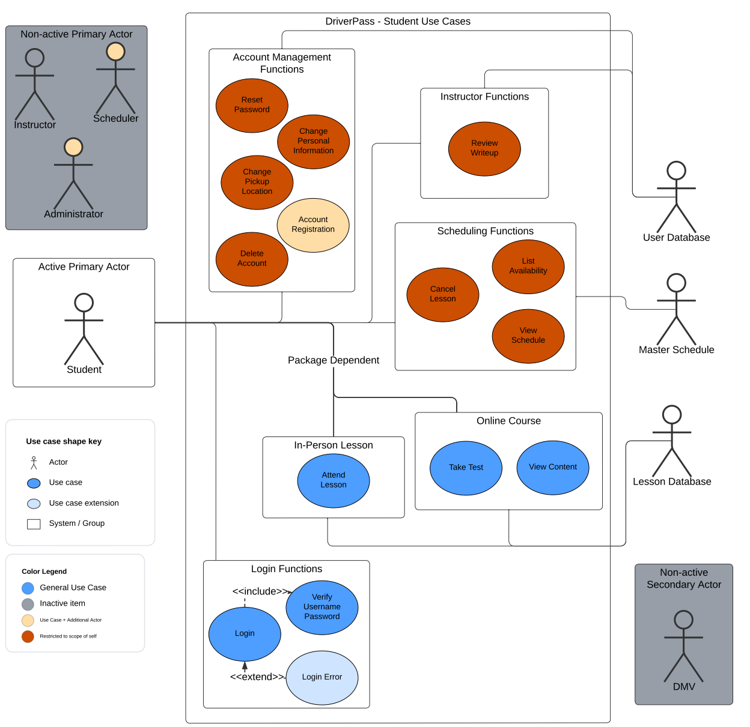
Use Case Diagram continued…
[Insert your use case diagram here.]
Notes:
[Explain your diagram. Who are the different actors in the system? What are the different use cases? How did you account for DriverPass’s needs in your design? In your explanation, keep your audience in mind. Avoid the use of terms like “actors” and “use cases” in your explanation.]
This slide may also seem a little bit daunting, but like before take a little time to glance at what is actually there:
We are specifically looking at the DriverPass program as experienced by a Student. We can see some of the different groupings of tools and functions has gotten a bit smaller, and we now have some different colors associated with them.
- Blue shaped objects are general functions provided by DriverPass. Things like logging in and attending lessons.
- Red shaped objects are tools that can be used within the “scope” of that particular student. So, for example Account Management functions are red, meaning that particular student can only use those tools to change things within his or her own account.
- The one light yellow orange shape means that to do that specific thing, you need an additional person. So in this case, account registration would need an additional person, the scheduler or administrator shown on the left.
We can also now see some lines running around the picture. Those lines going from the student on the left to the DriverPass tools and functions in the middle represent student being able to access the features of the DriverPass Program. We can also see that things like in-person lessons and online course have a package dependent text over those lines, signifying they can only be accessed when the student has purchased a specific package that enables access to those features.
The lines running from the DriverPass program to the things on the right side of the diagram represent what will be interacted with when those tools within the DriverPass program are used. So for example, When the student accesses scheduling functions, say view schedule or list availability, it needs to access the master schedule. If the student wants to register or update their personal information or their pickup location it needs to access the user database and update it as required.

Slide 6
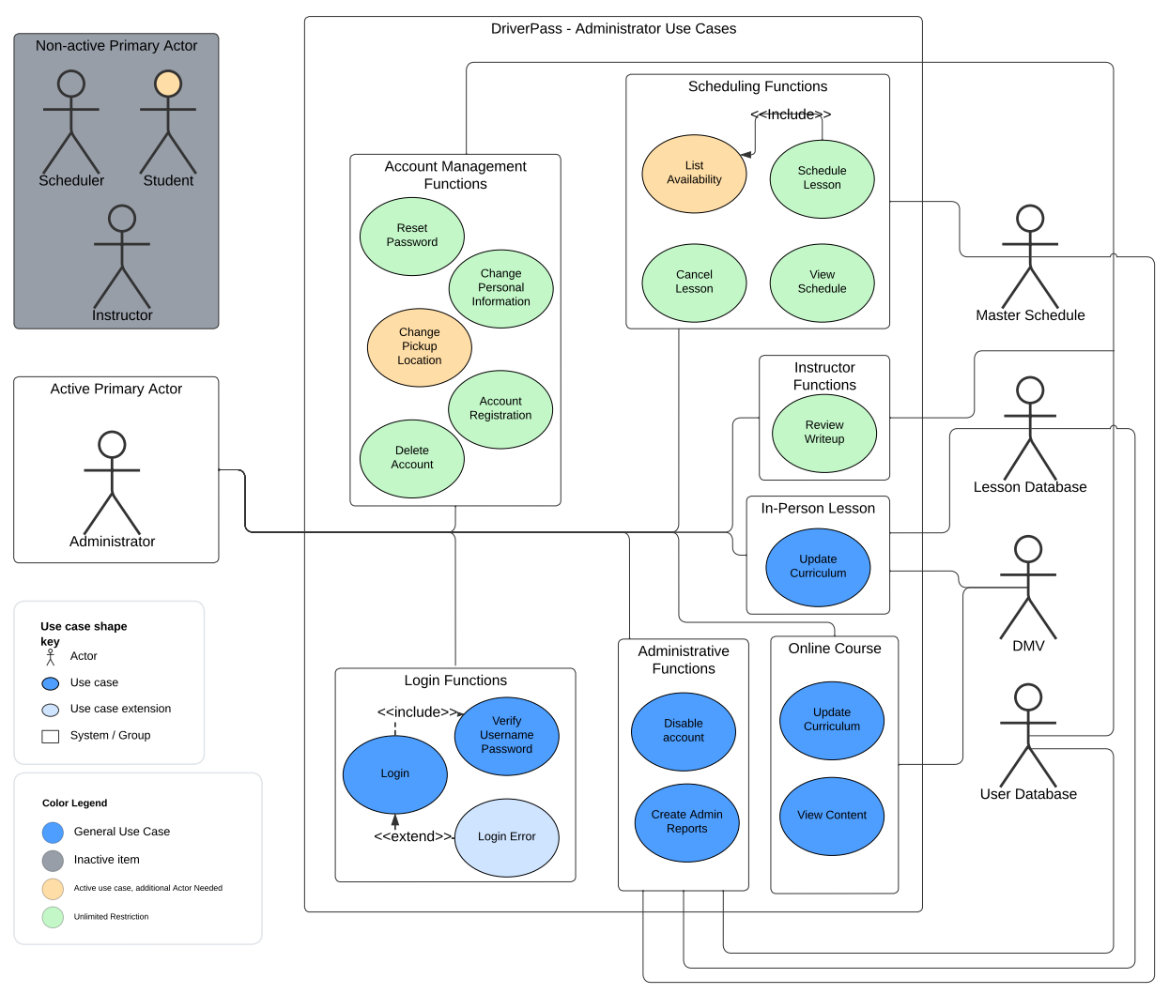
Use Case Diagram continued…
[Insert your use case diagram here.]
Notes:
[Explain your diagram. Who are the different actors in the system? What are the different use cases? How did you account for DriverPass’s needs in your design? In your explanation, keep your audience in mind. Avoid the use of terms like “actors” and “use cases” in your explanation.]
Now that we are somewhat familiar with what is going on, this should seem a little bit less daunting:
Here, we are specifically looking at the DriverPass program as experienced by an administrator. Take a little time to familiarize yourself with what is going on. This time, we have blue and yellow colored shapes, which mean roughly the same thing as before, but we have green colored shapes too. These signify unlimited restriction, meaning that administrators have unlimited restriction to most account management and scheduling functions. They would also have unlimited access to whose writeups they could view.
Having administrators be able to do such things with an unlimited restriction makes sense too: lets say there were no schedulers working at DriverPass. Then administrators would double up as a scheduler. Or if a student felt like their lesson writeup was unfair or maybe unprofessional, then the administrator would have rights to review writeups on any number of students to clarify.
Two other things that are unique to Administrators: they have access to administrator functions and update curriculum, which are self explanatory.

Slide 7
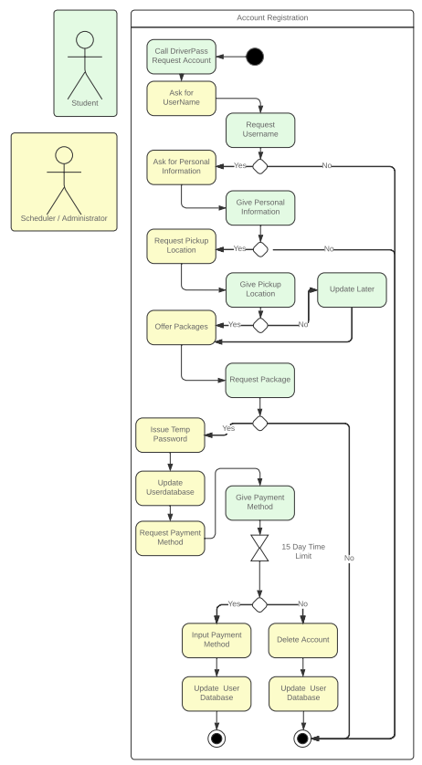
Activity Diagram
Notes:
[Explain your diagram. Which use case are you breaking down? What are the steps for this use case? How did you account for DriverPass’s needs in your design? In your explanation, keep your audience in mind. Avoid the use of technical terms such as “nodes,” “control flows,” and so on.]
This diagram represents the process of registration, student registration specifically. We can see that there is quite a bit going on:
We have two people on the left side of the diagram that have colored squares around them: Students, which have a green background and Scheduler / Administrator that have a yellow background. Each color represents the respective person and what they’re doing in the diagram on the right.
There are squares within the diagram on the right, each square represents a step within the registration process. They are color coded, indicating who will be doing what step.
Diamonds represent a fork in the process where, if the step doesn’t happen, the process will take a different turn.
Lines and arrows represent the flow of the registration process, while the solid dot represents the start of the process and the solid dot with a circle around it represents its termination.
The two hollow triangles pointing at each other represents a time sensitive action which will be explained later.
Now, take a little bit of time to look at the diagram on the right, reading the text of each box and taking note of the color. You start to see a back and forth between the student and the scheduler / administrator.
Starting from the top of the Diagram, we see the process starts with a phone call by the student which is taken by either a scheduler or administrator who asks for a desired username. Students either give one or don’t. If they don’t, the process gets terminated. If they give one, its on to Requesting personal information which students will give or they wont. If they don’t, it will lead to process termination. If they give the appropriate information, its on to requesting a pick up location which they will provide or they wont. In either case the process will move on to the scheduler or administrator offering a package. This is a mandatory step, if they don’t decide on a package, the process leads to termination: this makes sense to have happen because otherwise DriverPass’s User Database may have excess accounts, which would be vulnerable to exploitation and would also use up precious data space on the server. Once the student requests a package, the scheduler or administrator will issue out a temporary password, the student account will be finalized, and user database will update with the new student in the system. The process continues on with requesting a payment method for the package requested. Here, we see the time sensitive action. The student has 15 days to provide a valid payment method. If they don’t provide a valid payment method within 15 days, the system will delete their account and update the user database. Just like before, this will remove excess accounts limiting opportunities for exploitation and reduce user database size. If they do, the person performing the registration updates their payment method and updates the user database. This could also be accomplished by the student on their own and it would result in the same updating of the user database.

Slide 8
Security
Most Security Measures implemented are based on three main principals: controlling, denying and limiting.
Different user accounts will have access to different assigned tools.
Eliminating Anonymity during registration.
Giving a student account a lifespan if no payment method is provided.
Controlling who gets administrative rights by limiting who does administrative account registration.
Usernames and passwords will be case sensitive and include the use of symbols.
Limiting attempts to access accounts to a maximum of three attempts with incorrect information before they become disabled.
Implementing an auto-block feature that blocks accounts based on what they look at and how often they look at it.
Utilization of cloud services gives is a broad range of protective measures such as IP address blocking.
Notes:
[How did you consider security in your design? In your explanation, keep your audience in mind by avoiding the use of technical terms.]
Security measures that were implemented during system design revolve around principals of controlling, denying and limiting.
Limiting who has access to what by narrowing the scope of tools users have access to based on the type of user.
Denying student users anonymity when signing up by requiring them to call DriverPass first.
Limiting the amount of time students have access to their account if they don’t pay for the package requested.
Controlling who gets administrative rights by only letting administrators register other administrators.
Other things that were implemented:
When assigning usernames and passwords, they should be case sensitive, have a minimum length, particularly passwords, and they should have the option of including symbols. This exponentially increases the amount of characters needed for a brute force attack to occur and be successful.
Having three login attempts maximum before accounts get disabled would deny brute force attacks.
If a brute force attack happens, having an account block feature based on what information is being accessed or how much of that information is being accessed would limit damage done. An example of this would be an administrator’s account looking at 10 student’s payment methods within a small time frame would trigger an auto block: there would be no reason for an administrator to view that many different payment methods within, say, a 10 minute time frame. Also keep in mind that inputting payment methods wouldn’t be considered the same as viewing payment methods.
Utilization of cloud-based services would allow DriverPass to take full advantage of security services offered by larger companies also giving flexibility to block IP addresses, etc...

Slide 9
System Limitations
An online only environment could potentially be a limiting factor particularly for elder people.
Registering for DriverPass over the phone could be a limiting factor: Miscommunication during registration and a younger generation not familiar with registering for services over the phone would likely be impacted.
Notes:
[What are the limitations of your design? In your explanation, keep your audience in mind by avoiding the use of technical terms.]
While working out the details of DriverPass, there were a few things that stood out as possible limiting factors in the use of your system:
While many of us are used to an online environment, there are some that still have not adapted. Particularly elderly people who have either lost their licenses and are looking to earn it back or who never earned it but are looking to.
Registration occurring over the phone only presents several obstacles. Miscommunication, whether that’s misspelling, incorrect hyphenation and mis-capitalization is likely to occur. If this were to happen when the new user is choosing a username and the user mis-writes or mis-remembers their Username, or those that are registering the new user mis-type what has been told to them, then its likely that DriverPass would need to have a password reset and a username reset or recovery feature as well. This is not included in this system design as it sits. Any accounts that were abandoned as a result would pose a security risk.
In addition to miscommunication, having a younger generation being used to register for so many services online may deter people from approaching DriverPass to begin with if they are required to register by phone only. This may seem silly, but even the smallest hurdle may deter people from using services that are designed to help them, regardless of how helpful those services are.

